Slide 1
Stacks

Slide 2
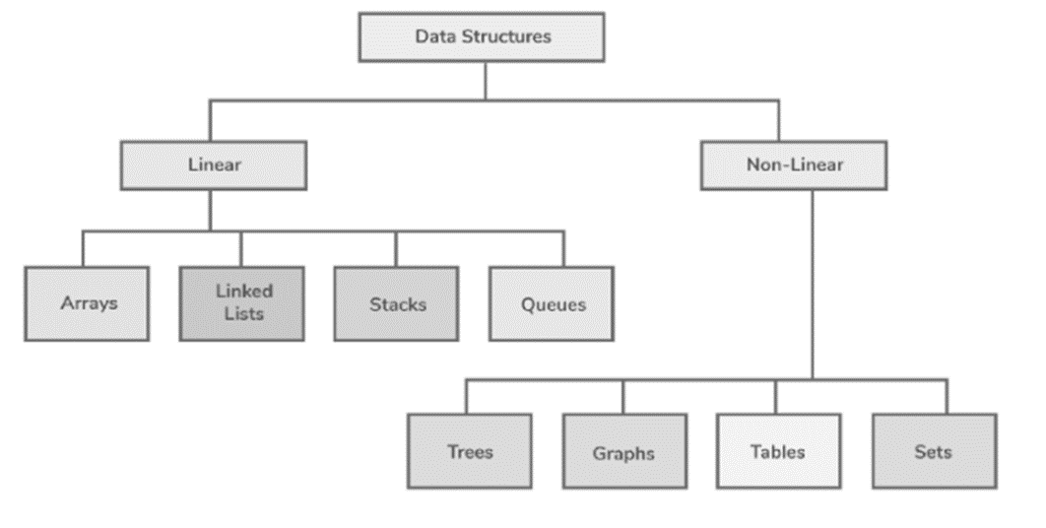
STACKS
Stacks

Slide 3
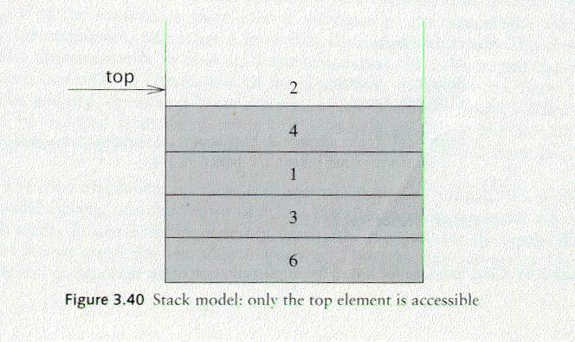
Stack Overview
Stack: A Stack is a list of elements in which an element may be inserted or deleted only at one end called the top of the stack Lists( LIFO (Last In, First Out) )
Basic operations of stack
  “Push” is the term used to insert an element into a stack.
  “Pop” is the term used to delete an element from stack. etc.
empty stack
push an element
push another
pop
top
B
top
top
top
A
A
A

Slide 4
Implementations of stacks
Any list implementation could be used to implement a stack
  Arrays (static: the size of stack is given initially)
  Linked lists (dynamic: never become full)
Array Representation:
1 | 2 | 3 | 4 | 5 | 6 | 7 | 8
XXX | YYY | ZZZ | AAA | BBB
TOP
MAXSTK

Slide 5
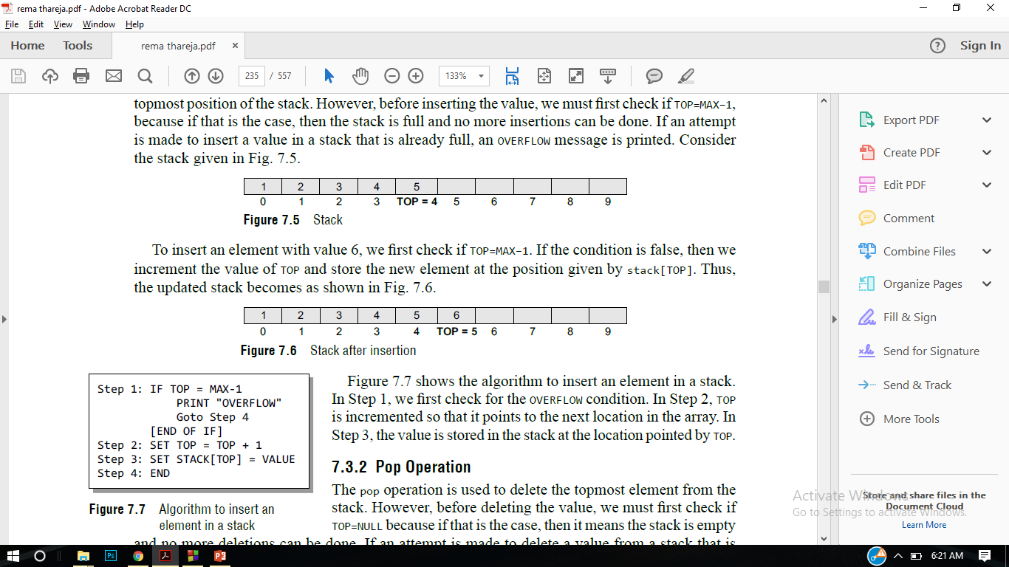

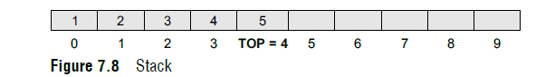

Array Implementation

Slide 6
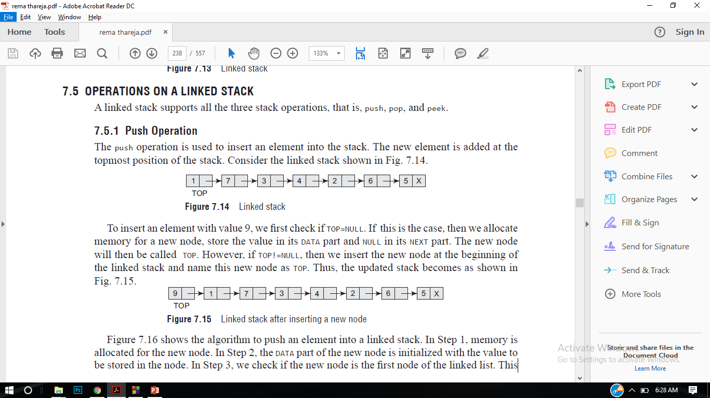
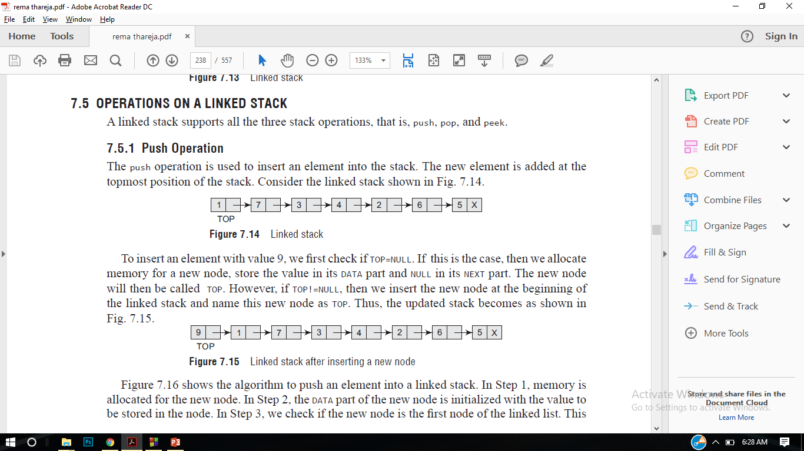
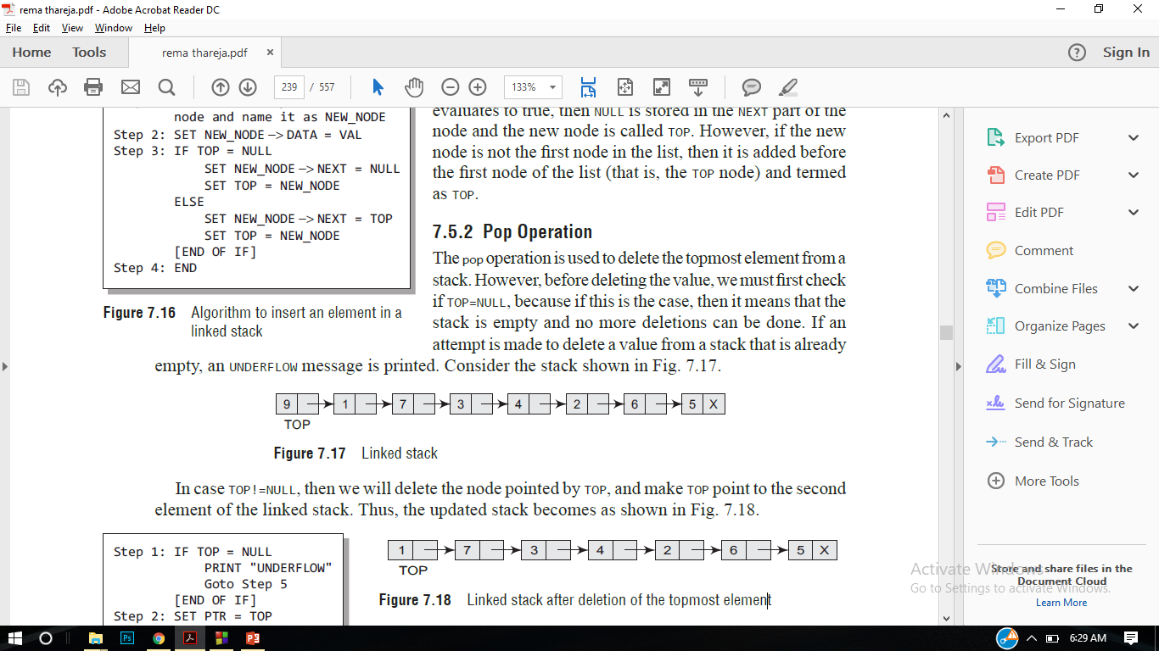
Linked List Implementation of Stack

Slide 7
Array Implementation
Need to declare an array size ahead of time
Associated with each stack is TopOfStack
  for an empty stack, set TopOfStack to -1
Push
  (1) Increment TopOfStack by 1.
  (2) Set Stack[TopOfStack] = X
Pop
  (1) Set return value to Stack[TopOfStack]
  (2) Decrement TopOfStack by 1
These operations are performed in very fast constant time

Slide 8
PUSH(STACK, Top, MaxStk, Item)
  [Stack already filled]
  if TOP=MAXSTK then print: overflow and return
  2) Set TOP=TOP+1 [Increases top by 1]
  3) Stack[TOP]=Item.
  4) Return.
POP( Stack, Top, Item)
  [Stack Empty]
  if TOP=0 then print: Under flow and return
  2) ) Item =. Stack[TOP] [Assign top element to item]
  3) Set TOP=TOP-1 [Decreases top by 1]
  4) Return.

Slide 9
Stack implementation with arrays #include <iostream> #include <stdlib.h> #define MAX 3 // Altering this value changes size of stack created int st[MAX], top=-1; void push(int st[], int val); int pop(int st[]); int peek(int st[]); void display(int st[]); int main() { int val, option; do { cout<<"\n *****MAIN MENU*****"; cout<<"\n 1. PUSH"; cout<<"\n 2. POP"; cout<<"\n 3. PEEK"; cout<<"\n 4. DISPLAY"; cout<<"\n 5. EXIT"; cout<<"\n Enter your option: "; cin>>option;

Slide 10
switch(option) { case 1: cout<<"\n Enter the number to be pushed on stack: "); cin>>val); push(st, val); break; case 2: val = pop(st); if(val != -1) cout<<"\n The value deleted from stack is: ", val); break; case 3: val = peek(st); if(val != -1) cout<<"\n The value stored at top of stack is: ", val); break; case 4: display(st); break; } }while(option != 5); return 0; }

Slide 11
void push(int st[], int val) { if(top == MAX-1) { cout<<"\n STACK OVERFLOW"; } else { top++; st[top] = val; } } int pop(int st[]) { int val; if(top == -1) { cout<<"\n STACK UNDERFLOW"; return -1; } else { val = st[top]; top--; return val;} }

Slide 12
void display(int st[]) { int i; if(top == -1) cout<<"\n STACK IS EMPTY"; else { for(i=top;i>=0;i--) cout<<"\n ",st[i]; cout<<"\n"; // Added for formatting purposes } } int peek(int st[]) { if(top == -1) { cout<<"\n STACK IS EMPTY"; return -1; } else return (st[top]); }

Slide 13
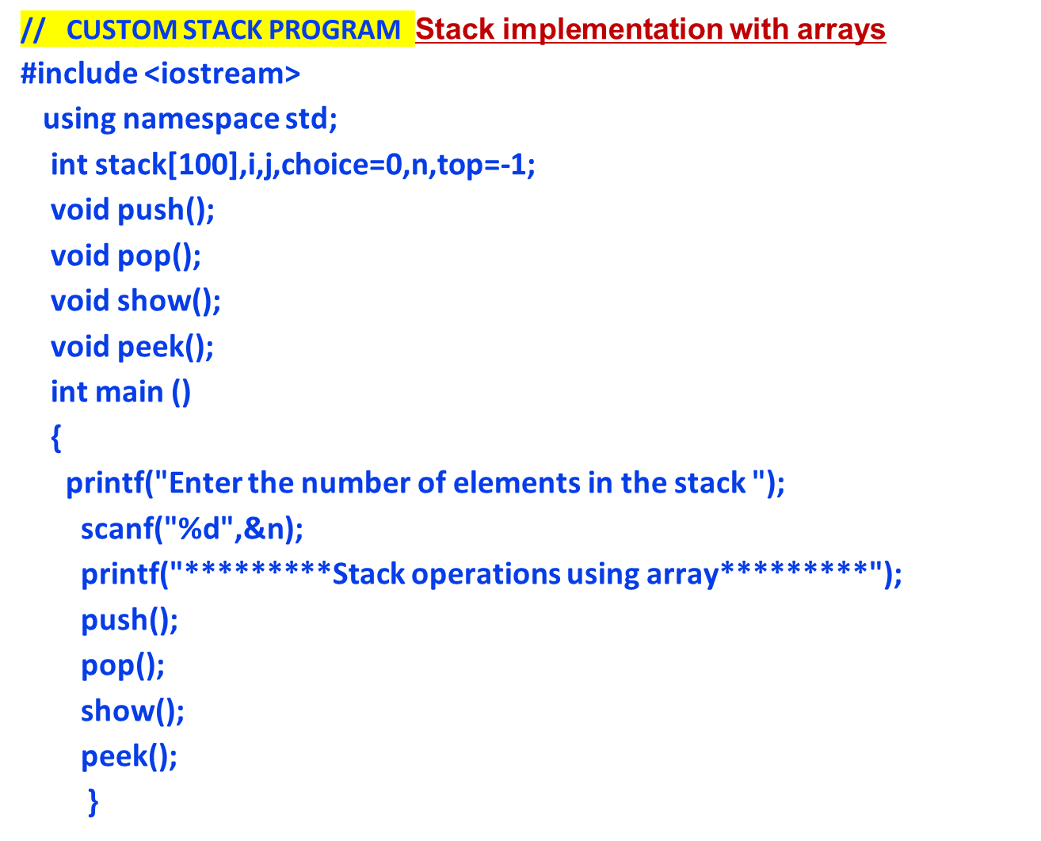

Slide 14
void push ()
{ int val; if (top == n ) printf("\n Overflow"); else
{ for(int i=0;i<=n;i++)
{ printf("Enter the value?"); scanf("%d",&val); top = top +1; stack[top] = val;
}
}
}

Slide 15
void pop ()
{ if(top == -1) printf("Underflow"); else top = top -1;
} void show()
{ for (i=top;i>=0;i--)
{ printf("%d\n",stack[i]);
} if(top == -1)
{ printf("Stack is empty");
}
}

Slide 16
void peek()
{ if (top == -1)
{ printf("Underflow");
} else
{ cout<<"peek elemmt : "<<stack [top];
}
}

Slide 17
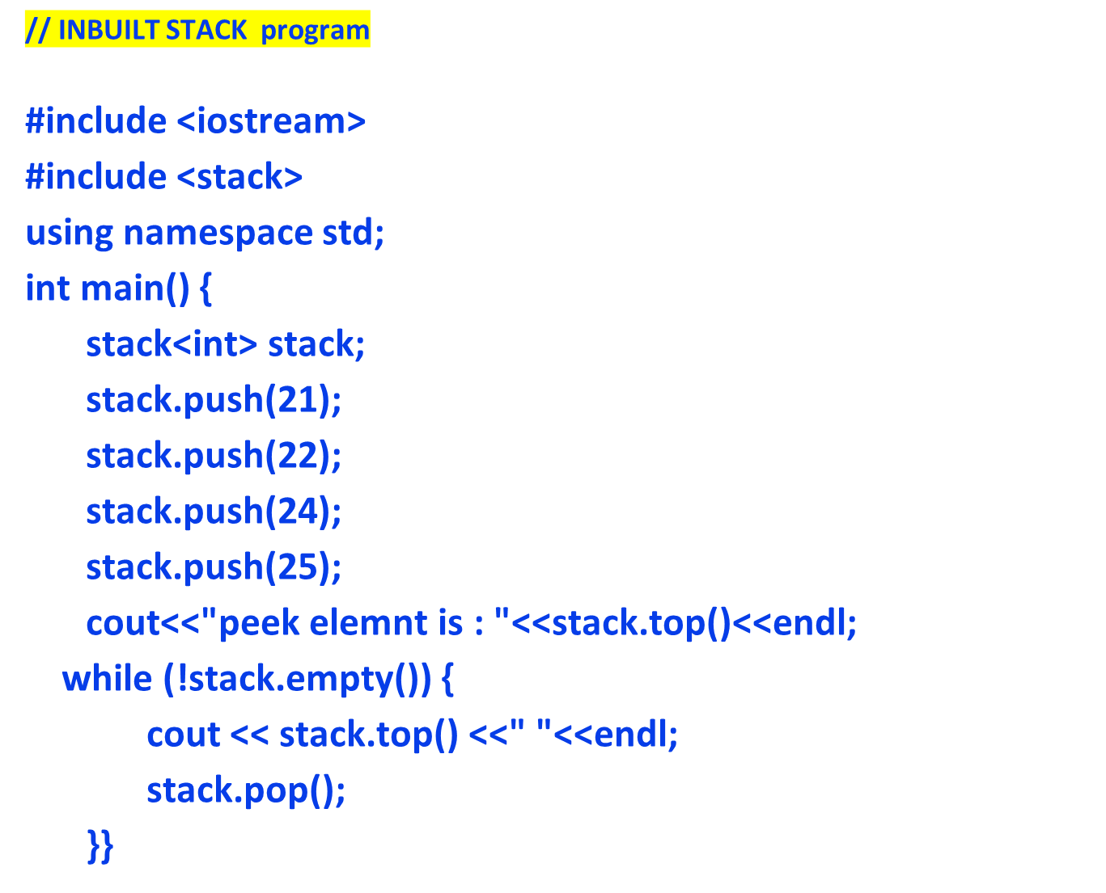

Slide 18
#include <iostream>
#include <stack> using namespace std; int main() { stack<int> stack; stack.push(21); stack.push(22); stack.push(24); stack.push(25); cout << "Peek element is: " << stack.top() << endl; while (!stack.empty()) { cout << stack.top() << " "; stack.pop();
} if (!stack.empty()) { cout << "\nPeek element is: " << stack.top() << endl;
} else { cout << "\nStack is empty." << endl;
} return 0;
}

Slide 19
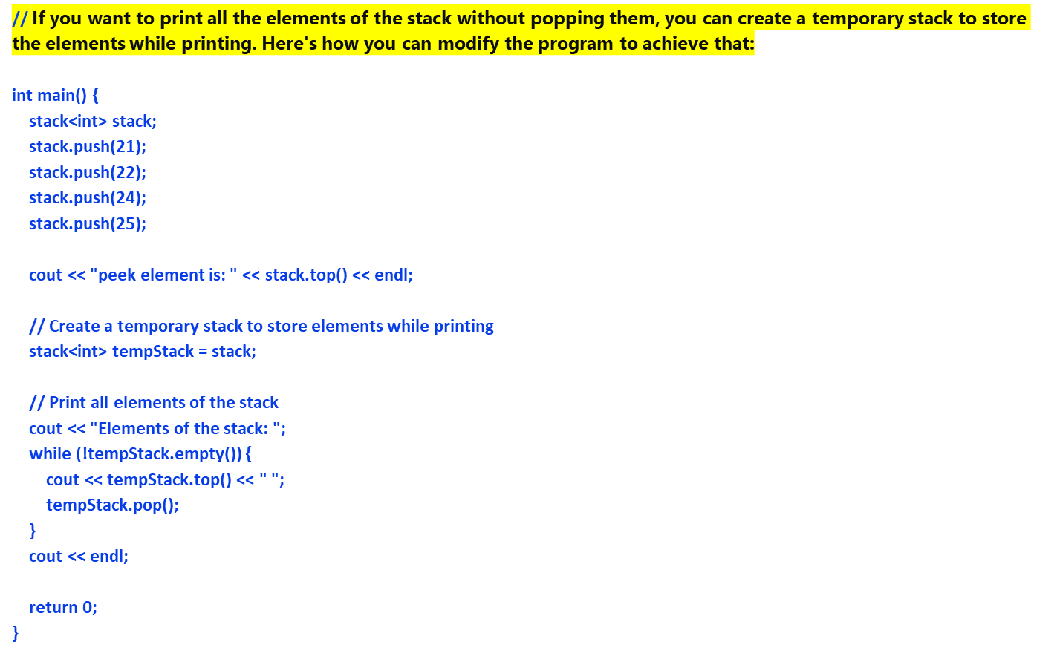

Slide 20
In this modified version of the program, a temporary stack tempStack is
created and
initialized with the same elements as the original stack.
Then, the elements are printed from the temporary stack without
popping them, leaving
the original stack unchanged.

Slide 21
Linked List Implementation of Stack

Slide 22
Stack implementation using LinkedList #include <iostream> #include<stdlib.h> using namespace std; struct stack{ int data; struct stack *next; }; struct stack *top =NULL; struct stack *push(struct stack *top, int value) { struct stack *temp; temp = new stack; temp->data =value; if(top == NULL) { top = temp; top->next = NULL; } else{ temp->next = top; top=temp; }

Slide 23
return top; } struct stack *pop(struct stack *top) { struct stack *temp; temp = top; if(top == NULL) { cout<<"Empty stack"; } else{ top=top->next; cout<<"The value being deleted:::"<<temp->data; free(temp); } return top; } int peek(struct stack *top) { return top->data; } struct stack *display(struct stack *top) { struct stack *ptr = top; if(top==NULL)

Slide 24
{ cout<<"stack is empty"; } else { while(ptr!=NULL) { cout<<ptr->data<<endl; ptr=ptr->next; } } return top; } int main() { int choice,value; cout<<"Enter choice"; cin>>choice; while(1) { switch(choice) { case 1: cout<<"Enter the value";

Slide 25
cin>>value; top = push(top , value); break; case 2: top=pop(top); break; case 3: top=display(top); break; case 4: int value1 = peek(top); cout<<value1<<endl; break; // default: // cout<<"Invalid Input"; } cout<<"Enter choice"; cin>>choice; } return 0; }

Slide 26
Applications of Stacks
  Evaluating postfix expressions
  Converting Infix to postfix expression
  Tower of Hanoi problem
  Factorial of a number
  Fibonacci series
  Recursion

Slide 27
Arithmetic Expression; Polish Notation
Polish Notation:
For most common arithmetic operations, the operator symbol is placed between its two operands: Example: A+B,C-D
This is called infix Notation. With this notation, we must distinguish between (A+B)* C and A + (B*C). By using parantheses or some operator-precedence convention.
Polish Notation: Refers to the notation in Which the operator symbol is placed before its two operands example: +AB,-CD
Translate the given infix notation into polish notation: Bracket[] indicate partial
(A+B)*C=[+AB]*C = *+ABC , A+(B*C)=A+[*BC]=+A*BC
(The Fundamental property of polish notation is that the order in which the operations are to be performed is completely determined by position of the operators and operands in the expression, one never need parenthesis when writing expression in polish notation)

Slide 28
In Reverse polish notation the operator symbol is placed after its two operands.Example: AB+ , CD-( one never needs a parenthesis to determine the order of the operations in any arithmetic expression)

Slide 29
Evaluation of postfix expression:- This algo
finds the value of arithmetic expression P written in postfix expression
Add a right parenthesis “) ” at the end of P.
Scan P from left to right and repeat steps 3 and 4 for each element of
P until “)” is encountered.
3. If an operand is encountered, put it on stack.
4. If an operator © is encountered, then
(a) Remove the top two elements from the stack, where A is the top
element and B is the next to top element
(b) Evaluate B © A
(c) Place the result of (b) back on the stack.
[END IF]
[END WHILE]
5. Set VALUE equal to the top element of stack.
6. Exit

Slide 30
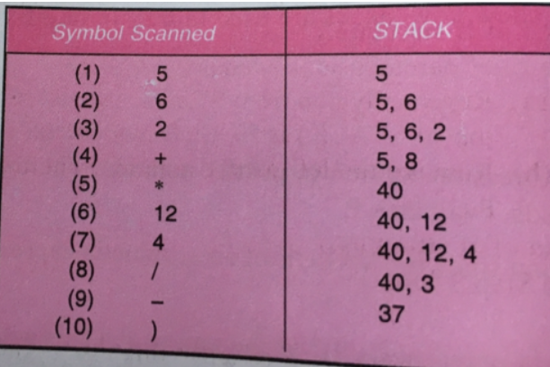
Infix: 5*(6+2)-12/4
P: 5,6,2,+,*,12,4,/,-

Slide 31
(2*3)+9-5+7

Slide 32
To evaluate the expression, we first convert it to postfix notation. We'll use the shunting-yard algorithm or stack-based method for conversion.
Infix: (2*3)+9-5+7 Postfix: 2 3 * 9 + 5 - 7 +
Evaluation of Postfix Expression: Now that we have the expression in postfix notation, we can evaluate it using a stack-based algorithm. We scan the expression from left to right:
  Push operands onto the stack.
  When we encounter an operator, pop the required number of operands from the stack, perform the operation, and push the result back onto the stack.
Postfix: 2 3 * 9 + 5 - 7 +
Scan from left to right:
  Push 2 onto the stack.
  Push 3 onto the stack.
  Encounter '*', so pop 2 and 3 from the stack, perform multiplication (2 * 3 = 6), and push the result (6) back onto the stack.
  Push 9 onto the stack.
  Encounter '+', so pop 6 and 9 from the stack, perform addition (6 + 9 = 15), and push the result (15) back onto the stack.
  Push 5 onto the stack.
  Encounter '-', so pop 15 and 5 from the stack, perform subtraction (15 - 5 = 10), and push the result (10) back onto the stack.
  Push 7 onto the stack.
  Encounter '+', so pop 10 and 7 from the stack, perform addition (10 + 7 = 17), and push the result (17) back onto the stack.
Result: The result of evaluating the infix expression (2*3)+9-5+7 is 17.

Slide 33
Transforming INFIX NOTATION in to POSTFIX NOTATION Algo: POLISH(Q,P) Suppose Q is an arithmetic expression written in infix notation. This algorithm finds the Equivalent Postfix expression:
      Push “(“ on to the STACK, and add “)” to end of the Q
      Scan Q from Left to Right and Repeat Steps 3 to 6 for Each Element of Q until the Stack is empty.
      If an operand is encountered, add to P.
      If a left parenthesis is encountered, PUSH it on to STACK
      If an operator © is encountered, then:
        Repeatedly POP from Stack and Add to P each operator( on the top of the stack) which has the same precedence as or higher precedence than ©
        ADD © to stack.
      If a right parenthesis is encountered, then:
        Repeatedly POP from Stack and Add to P each operator until a left parenthesis is encountered.
        Remove the left parenthesis [ Do not add to P].
      EXIT

Slide 34
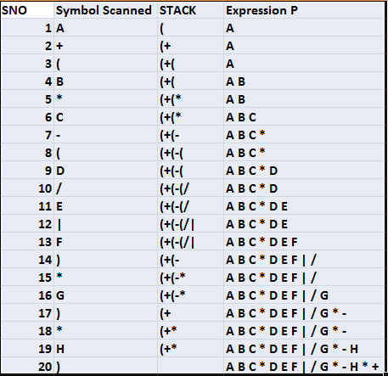
A+(B*C-(D/E|F)*G)*H

Slide 35
1. A*(B+C-D) =>ABC+D-*
2. A+B/C+D*(E-F)^ G => ABC/+DEF-G ^ *+
3.K+L-M*N+(O^ P)*W/U/V*T+Q =>
KL+MN*-OP^ W*U/V/T*+Q+
4. A+(B*C-(D/E|F)*G)*H =>ABC*DEF|/G*-H*+

Slide 36
Practice
1.((A+B)*D) Ȋ (E-F)
2. (A-B)*(D/E)
3. (A+B Ȋ D)/(E-F)+G
4. A*(B+D)/E-F*(G+H/K)
5. (A-B)*(D/E)
6. (A+B Ȋ D)/(E-F)+G

Slide 37
Converting infix expressions to postfix or prefix notation can be useful in various scenarios, primarily because these notations offer advantages in terms of evaluation and parsing.
Here are some reasons why converting infix expressions to postfix or prefix notation is beneficial:
Ease of Evaluation: Postfix and prefix notations are inherently more straightforward for computers to evaluate compared to infix notation. Infix notation requires consideration of operator precedence and parentheses, which adds complexity to the evaluation process. Postfix and prefix notations eliminate the need for parentheses and provide a clear order of operations, making evaluation more efficient.
No Ambiguity: Infix notation can sometimes be ambiguous, especially when dealing with operator precedence and parentheses. Converting to postfix or prefix notation removes this ambiguity by clearly defining the order of operations through the placement of operators.
Simplified Parsing: Postfix and prefix notations are easier to parse algorithmically compared to infix notation. This makes them particularly useful in compiler design, where parsing mathematical expressions is a common task.
Stack-Based Evaluation: Postfix and prefix notations lend themselves well to stack-based evaluation algorithms. The evaluation of postfix and prefix expressions can be done efficiently using a stack data structure, making them preferred choices in implementations where memory usage and performance are crucial factors.
Reduced Complexity: By eliminating the need for parentheses and reducing operator precedence considerations, postfix and prefix notations simplify expression manipulation and processing.
Overall, converting infix expressions to postfix or prefix notation offers advantages in terms of simplicity, efficiency, and ease of evaluation, which can be valuable in various computational contexts.

Slide 38
Evaluation of postfix Notation
Add A right parenthesis “)” at the end of P.
SCAN P from Left to Right and repeat steps 3 and 4 for each element of P until the “)” is encounterd
If an operand is encountered put it on stack
If an operator © is encountered then
  Remove the two top elements of stack, where A is the top element and B is the next top element.
  Evaluate B © A
  Place the result of 2 back on Stack.
Set value Equal to top element on Stack
Exit

Slide 39
EXAMPLE=
Q: 5*(6+2)-12/4
Postfix :5 6 2 + * 12 4 / -
Symbol Scanned | STACK
5 | 5
6 | 5,6
2 | 5,6,2
+ | 5,8
* | 40
12 | 40,12
4 | 40,12,4
/ | 40,3
- | 37
)

Slide 40
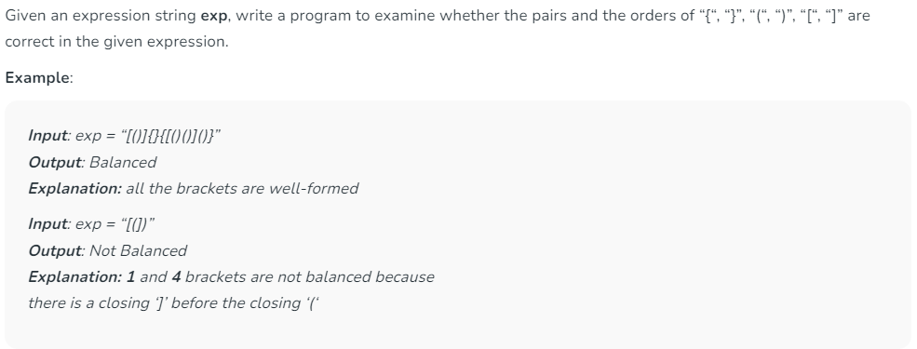
Check for Balanced Bracket expression using Stack

Slide 41
boolean isMatching(char a,char b) {
if(a=='(' && b==')') {
return true;
}
else if(a=='{' && b=='}') {
return true;
}
else if(a=='[' && b==']') {
return true;
}
return false;
}

Slide 42
boolean checkPrenthesis(String s) {
Stack<char> st;
for(int i=0;i<s.length();i++) {
char ch=s[i];
if(ch=='('||ch=='{' || ch=='[') {
st.push(ch);
}
else if(ch==')' || ch=='}'|| ch=='}') {
if(st.isEmpty() || !isMatching(st.peek(), ch)) {
return false;
}
else {
st.pop();
}
}
}
return st.isEmpty();
}

Slide 43
Recursion
  Suppose P is a procedure containing either a call statement to itself or a call statement to a second procedure that may eventually result in a call statement back to the original procedure P then P is called a Recursive Procedure. A program will not continue to run indefinitely.
  A recursive procedure must have the following two properties:
  Base case, in which the problem is simple enough to be solved directly without making any further calls to the same function.
  Recursive case, in which first the problem at hand is divided into simpler sub-parts. Second the function calls itself but with sub-parts of the problem obtained in the first step. Third, the result is obtained by combining the solutions of simpler sub-parts.

Slide 44
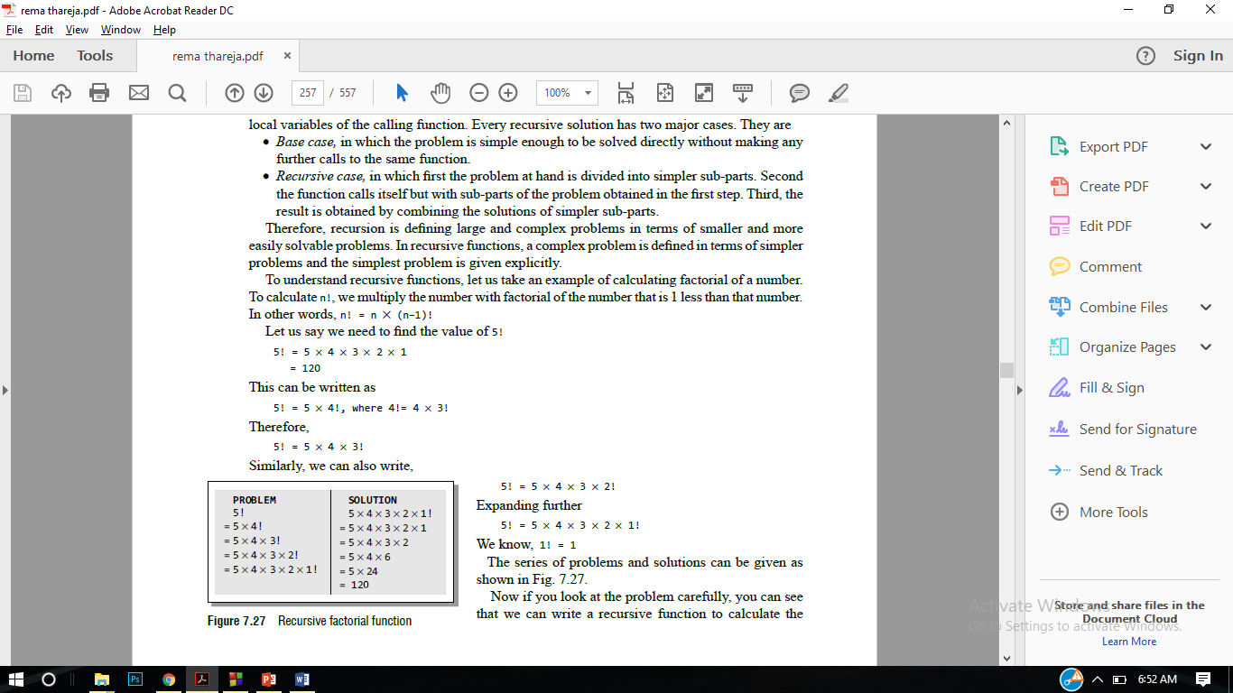
Factorial
To calculate n!, we multiply the number with factorial of the number that is 1 less than that number.
In other words, n! = n * (n–1)!
Let us say we need to find the value of 5!
5! = 5 * 4 * 3 * 2 * 1 = 120
This can be written as
5! = 5 * 4!, where 4!= 4 * 3!
Therefore,
5! = 5 * 4 * 3!

Slide 45
Base case is when n = 1, because if n = 1, the result will be 1 as 1! = 1.
Recursive case of the factorial function will call itself but with a smaller value of n, this case can be given as factorial(n) = n × factorial (n–1)
#include <iostream>
int Fact(int); // FUNCTION DECLARATION
int main()
{
int num, val;
cout<<"\n Enter the number: ";
cin>>num;
val = Fact(num);
cout<<"\n Factorial of “<< num << “is ” <<val;
return 0;
}
int Fact(int n)
{
if(n==1)
return 1;
else
return (n * Fact(n–1)); }

Slide 46
Questions
Ques : Implement push and pop operations on stacks using arrays.
Ques : Explain the concept of recursion by giving one example.
Ques : Implement push and pop operations on stacks using linked list.

Slide 47
Quicksort

Slide 48
Quicksort I: Basic idea
Pick some number p from the array
Move all numbers less than p to the beginning of the array
Move all numbers greater than (or equal to) p to the end of the array
Quicksort the numbers less than p
Quicksort the numbers greater than or equal to p
p
numbers less than p
p
numbers greater than or equal to p

Slide 49
Quicksort II
To sort a[left...right]:
1. if left < right:
  1.1. Partition a[left...right] such that:
  all a[left...p-1] are less than a[p], and
  all a[p+1...right] are >= a[p]
  1.2. Quicksort a[left...p-1]
  1.3. Quicksort a[p+1...right]
2. Terminate

Slide 50
Partitioning (Quicksort II)
A key step in the Quicksort algorithm is partitioning the array
  We choose some (any) number p in the array to use as a pivot
  We partition the array into three parts:
p
numbers less than p
p
numbers greater than or equal to p

Slide 51
Partitioning II
Choose an array value (say, the first) to use as the pivot
Starting from the left end, find the first element that is greater than or equal to the pivot
Searching backward from the right end, find the first element that is less than the pivot
Interchange (swap) these two elements
Repeat, searching from where we left off, until done

Slide 52
Partitioning
To partition a[left...right]:
1. Set pivot = a[left], l = left + 1, r = right;
2. while l < r, do
  2.1. while l < right & a[l] < pivot , set l = l + 1
  2.2. while r > left & a[r] >= pivot , set r = r - 1
  2.3. if l < r, swap a[l] and a[r]
3. Set a[left] = a[r], a[r] = pivot
4. Terminate

Slide 53
Example of partitioning
choose pivot: 4 3 6 9 2 4 3 1 2 1 8 9 3 5 6
search: 4 3 6 9 2 4 3 1 2 1 8 9 3 5 6
swap: 4 3 3 9 2 4 3 1 2 1 8 9 6 5 6
search: 4 3 3 9 2 4 3 1 2 1 8 9 6 5 6
swap: 4 3 3 1 2 4 3 1 2 9 8 9 6 5 6
search: 4 3 3 1 2 4 3 1 2 9 8 9 6 5 6
swap: 4 3 3 1 2 2 3 1 4 9 8 9 6 5 6
search: 4 3 3 1 2 2 3 1 4 9 8 9 6 5 6 (left > right)
swap with pivot: 1 3 3 1 2 2 3 4 4 9 8 9 6 5 6

Slide 54
Partitioning at various levels

Slide 55
Recursion:
Suppose P is a procedure containing either a call statement to itself or a call statement to a second procedure that may eventually result in a call statement back to the original procedure P then P is called a Recursive Procedure. A program will not continue to run indefinitely a recursive procedure must have the following two properties:
There must be certain criteria, called base criteria for which the procedure does not call itself.
Each time the procedure does call itself, it must be closer to the base Criteria.
A recursive procedure with these two properties is said to be well defined.
Example:
Tower of Hanoi:

Slide 56
Rules
1. Only one disk may be moved at a time. Specifically, only the top disk on any peg may be moved to any other peg.
2. At no time can a larger disk be placed on a smaller disk
Move the top N-1 disks from peg A to Peg B.
Move the top disk from PEG A to Peg C, A -> C
Move the top n-1 disks from peg B to C
Sol:
Tower(N-1,Beg,End,Aux)
Tower(1,Beg,Aux,End)
Tower(N-1,Aux,Beg,End)

Slide 57
1. A*(B+C-D) =>ABC+D-*
2. A+B/C+D*(E-F)^ G => ABC/+DEF-G ^ *+
3.K+L-M*N+(O^ P)*W/U/V*T+Q =>
KL+MN*-OP^ W*U/V/T*+Q+
4. A+(B*C-(D/E|F)*G)*H =>ABC*DEF|/G*-H*+

Slide 58
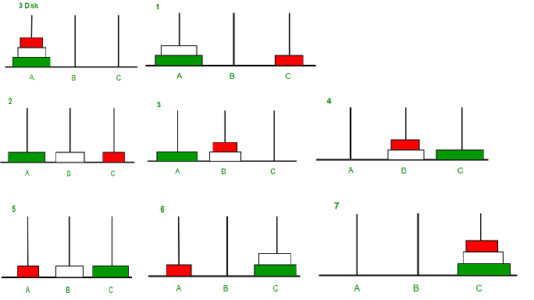


Slide 59
Tower (N, Beg, Aux, End)
1 If N=1 then
a) Write Beg -> End
b) Return
2 Call Tower(N-1,Beg,End,Aux)
3 Write Beg -> End
4 Call Tower(N-1,Aux,Beg,End)
5 Return

